Slide 1
Clinical sequencing defines the genomic landscape of metastatic colorectal cancer - Paper Analysis
Adam Wojtulewski
Machine Learning Department
Moffitt Cancer Center

Slide 2
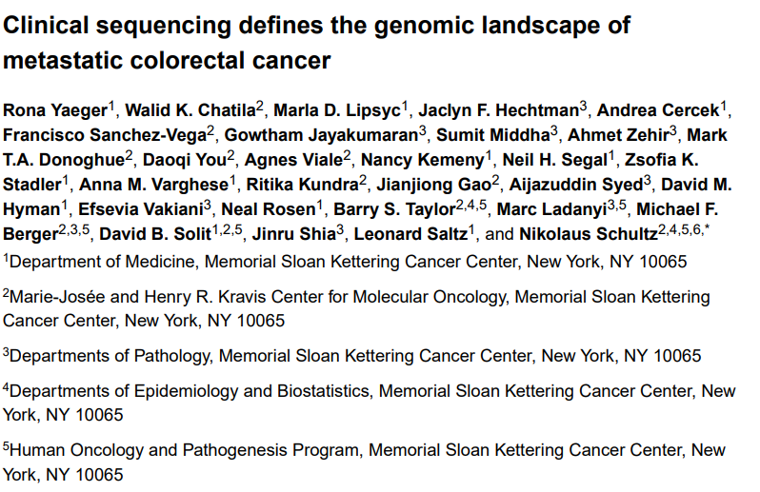
Paper Title and Details
Title and Authors
How to Access Paper
https://www.cbioportal.org/study/summary?id=crc_msk_2017
https://www.ncbi.nlm.nih.gov/pmc/articles/PMC5765991/
https://github.com/AdamWojtul28/Moffitt-Data-Analysis

Slide 3
Background
“Metastatic colorectal cancers (mCRCs) are clinically heterogeneous, but the genomic basis of this variability remains poorly understood.”
“Metastatic CRC (mCRC)… is the third most common cause of cancer death worldwide [now second] and there is a growing incidence of CRC, often metastatic, among younger patients”
“Comprehensive sequencing studies, such as The Cancer Genome Atlas (TCGA) (Cancer Genome Atlas Network, 2012; Giannakis et al., 2016; Haan et al., 2014), have defined molecular subtypes of CRC, microsatellite instability-high (MSI-H)/hypermutated, and microsatellite stable (MSS) CRCs (Donehower et al., 2013).
The latter is less treatable because stability makes it difficult for the body to detect it and implement countermeasures.

Slide 4
Goal/Purpose of the Study
“The goal of this study is to define the genomic landscape of metastatic tumors and to identify prognostic and predictive biomarkers. Additionally, by analyzing mCRC within the clinical setting, we aimed to evaluate how often genomic analysis provides clinically actionable therapeutic information.”

Slide 5
Data
C:\Users\adamr\Moffitt-Work\Moffitt-Data-Analysis\Publication PDFs\NIHMS928716-supplement-2.xlsx
https://www.ncbi.nlm.nih.gov/pmc/articles/PMC5765991/bin/NIHMS928716-supplement-2.xlsx

Slide 6
Sample Information
“Analyzed a total of 1134 colorectal adenocarcinomas, consisting of 1011 tumors (478 primaries, 533 metastases) from 979 patients with mCRC and 123 tumors from 120 patients with early-stage CRC”.
1027 MSS tumors (90.6%), 99 MSI-H/hypermutated tumors (8.7%), and 8 POLE mutant tumors (0.7%)
“Just over half of specimens (52%) were obtained before any treatment.”

Slide 7
Notable Statistics
“Forty-seven recurrently mutated genes [for MSS CRC] were identified, the most frequently mutated being APC (79%), TP53 (78%), KRAS (44%), PIK3CA (18%), and SMAD4 (16%).”
“Median age at diagnosis was significantly higher for MSI-H/hypermutated CRC patients than for MSS CRC patients (60 years versus 54 years, p=0.01).”

Slide 8
Interesting Trends to Look Into
“Potentially novel recurrently mutated genes in MSS CRC, which included PTPRS, PIK3CG, FLT4, MAP2K4, IKZF1, JUN, TBX3, FOXP1, INHBA, and CDKN1B.”
There is “a higher rate of liver and lung metastases with left-sided primary tumors and a higher rate of peritoneal metastases and metastases to other sites with right-sided primary tumors”
“BRAF mutations have been associated with increased peritoneal disease and ascites and KRAS mutations have been associated with increased ovarian metastases, both genotypes enriched in right-sided primary tumors”

Slide 9
Main Findings
“Long CTNNB1 exon 3 deletions were most common in CRC”; 20 in this study”
“these long deletion events are highly enriched in CRC, suggesting differences in the mechanisms of WNT pathway activation in CRC”
“Beyond microsatellite instability, potentially actionable alterations were enriched in MSI-H/hypermutated tumors compared with MSS tumors (86% versus 37%)”
“Data suggest that the survival differences seen between patients having right- and those having left-sided primary tumor sites in mCRC are largely driven by genomic differences.”

Slide 10
Left vs Right Primary Site
“We found that the 5-year median OS for patients with right-sided tumors was 45% compared to 67% for patients with left-sided tumors”
Tumor stage at diagnosis:
Left-sided MSS mCRC, was 3% stage I, 8% stage II, 22% stage III, and 67% stage IV
Right-sided MSS mCRC, was 1% stage I, 6% stage II, 20% stage III, and 73% stage IV
The frequency of single site of metastasis at the time of diagnosis of metastatic disease: 66% of right-sided tumors versus 74% of leftsided mCRC
Patients younger than 50 years: 19% have right-sided primaries and 81% have left-sided primaries
Patients 50 years or older, 31% have right-sided primaries and 69% have leftsided primaries

Slide 11
Impact of Differing Genomic Landscape
“Using these genes in a multivariate model correcting for primary tumor location, oncogenic alterations in APC (HR=0.57, p<0.01), BRAF (HR=2.02, p<0.001), KRAS (HR=1.40, p<0.01), and NRAS (HR 2.59, p<0.01) were predictive of survival, whereas primary site was not”
We identified five subgroups from this analysis, each with differing distribution by primary tumor site
(1) RTK activated alone, (2) RAS-MAPK pathway activated, (3) PI3K pathway activated, (4) concurrent RAS-MAPK/PI3K pathway activation, and (5) no alterations
Survival was longest for patients whose tumors had either no genomic pathway alteration or only RTK alterations.
Survival was shortest for patients whose tumors had RAS pathway alterations.

Slide 12
Paper Conclusions
“Since the most common first site(s) of metastasis varied significantly between right-sided and left-sided primaries, the varied pattern of metastasis by genomic subgroups may underlie this difference in metastatic tropisms by primary site and thus underlie survival differences seen between right-sided and left-sided primaries”
“Suggest that selective inhibitors of other RTKs, such ERBB2, may exhibit higher efficacy in left-sided tumors.”

Slide 13
Question
“We evaluated how often genomic analysis provides potentially clinically actionable therapeutic information in mCRC and compared the spectrum of targetable genomic alterations by primary tumor site. Using the OncoKB classification system (Chakravarty et al., 2017) (oncokb.org), we stratified genomic alterations by highest level of clinical actionability (Figure 3A). OncoKB assigns levels of actionability to genomic alterations based on evidence for the genomic alteration to serve as a biomarker either in that cancer type or in other cancer types.”
Were these treatments already given or were these projections made by the researchers for what would be best?

Slide 14
Successes of the Paper
Clear definitions and distinctions for each molecular subtype.
Included explanation for edge/tricky case
Justification of methods
Points to causes to OS of patients
Descriptive and varying figures
Easily the most informative are the ones that details the split between genes

Slide 15
Critiques of Paper
“Among MSI-H/hypermutated cases, median age at diagnosis was 72 years for BRAF V600E mutant cases and 55 years for cases without BRAF V600E mutation (p<0.01).”
This is a really specific case that is highlighted. No context for the importance is provided.
“Interestingly, this tumor also harbored ERBB2 amplification, another potential mechanism of cetuximab resistance.”
Potential mechanism based on what?
Use ‘potential’ several times, but do not always explain why this is the case
Figures separate from text
Figure 1B – lack of labels in the colored circles

